Slide 1
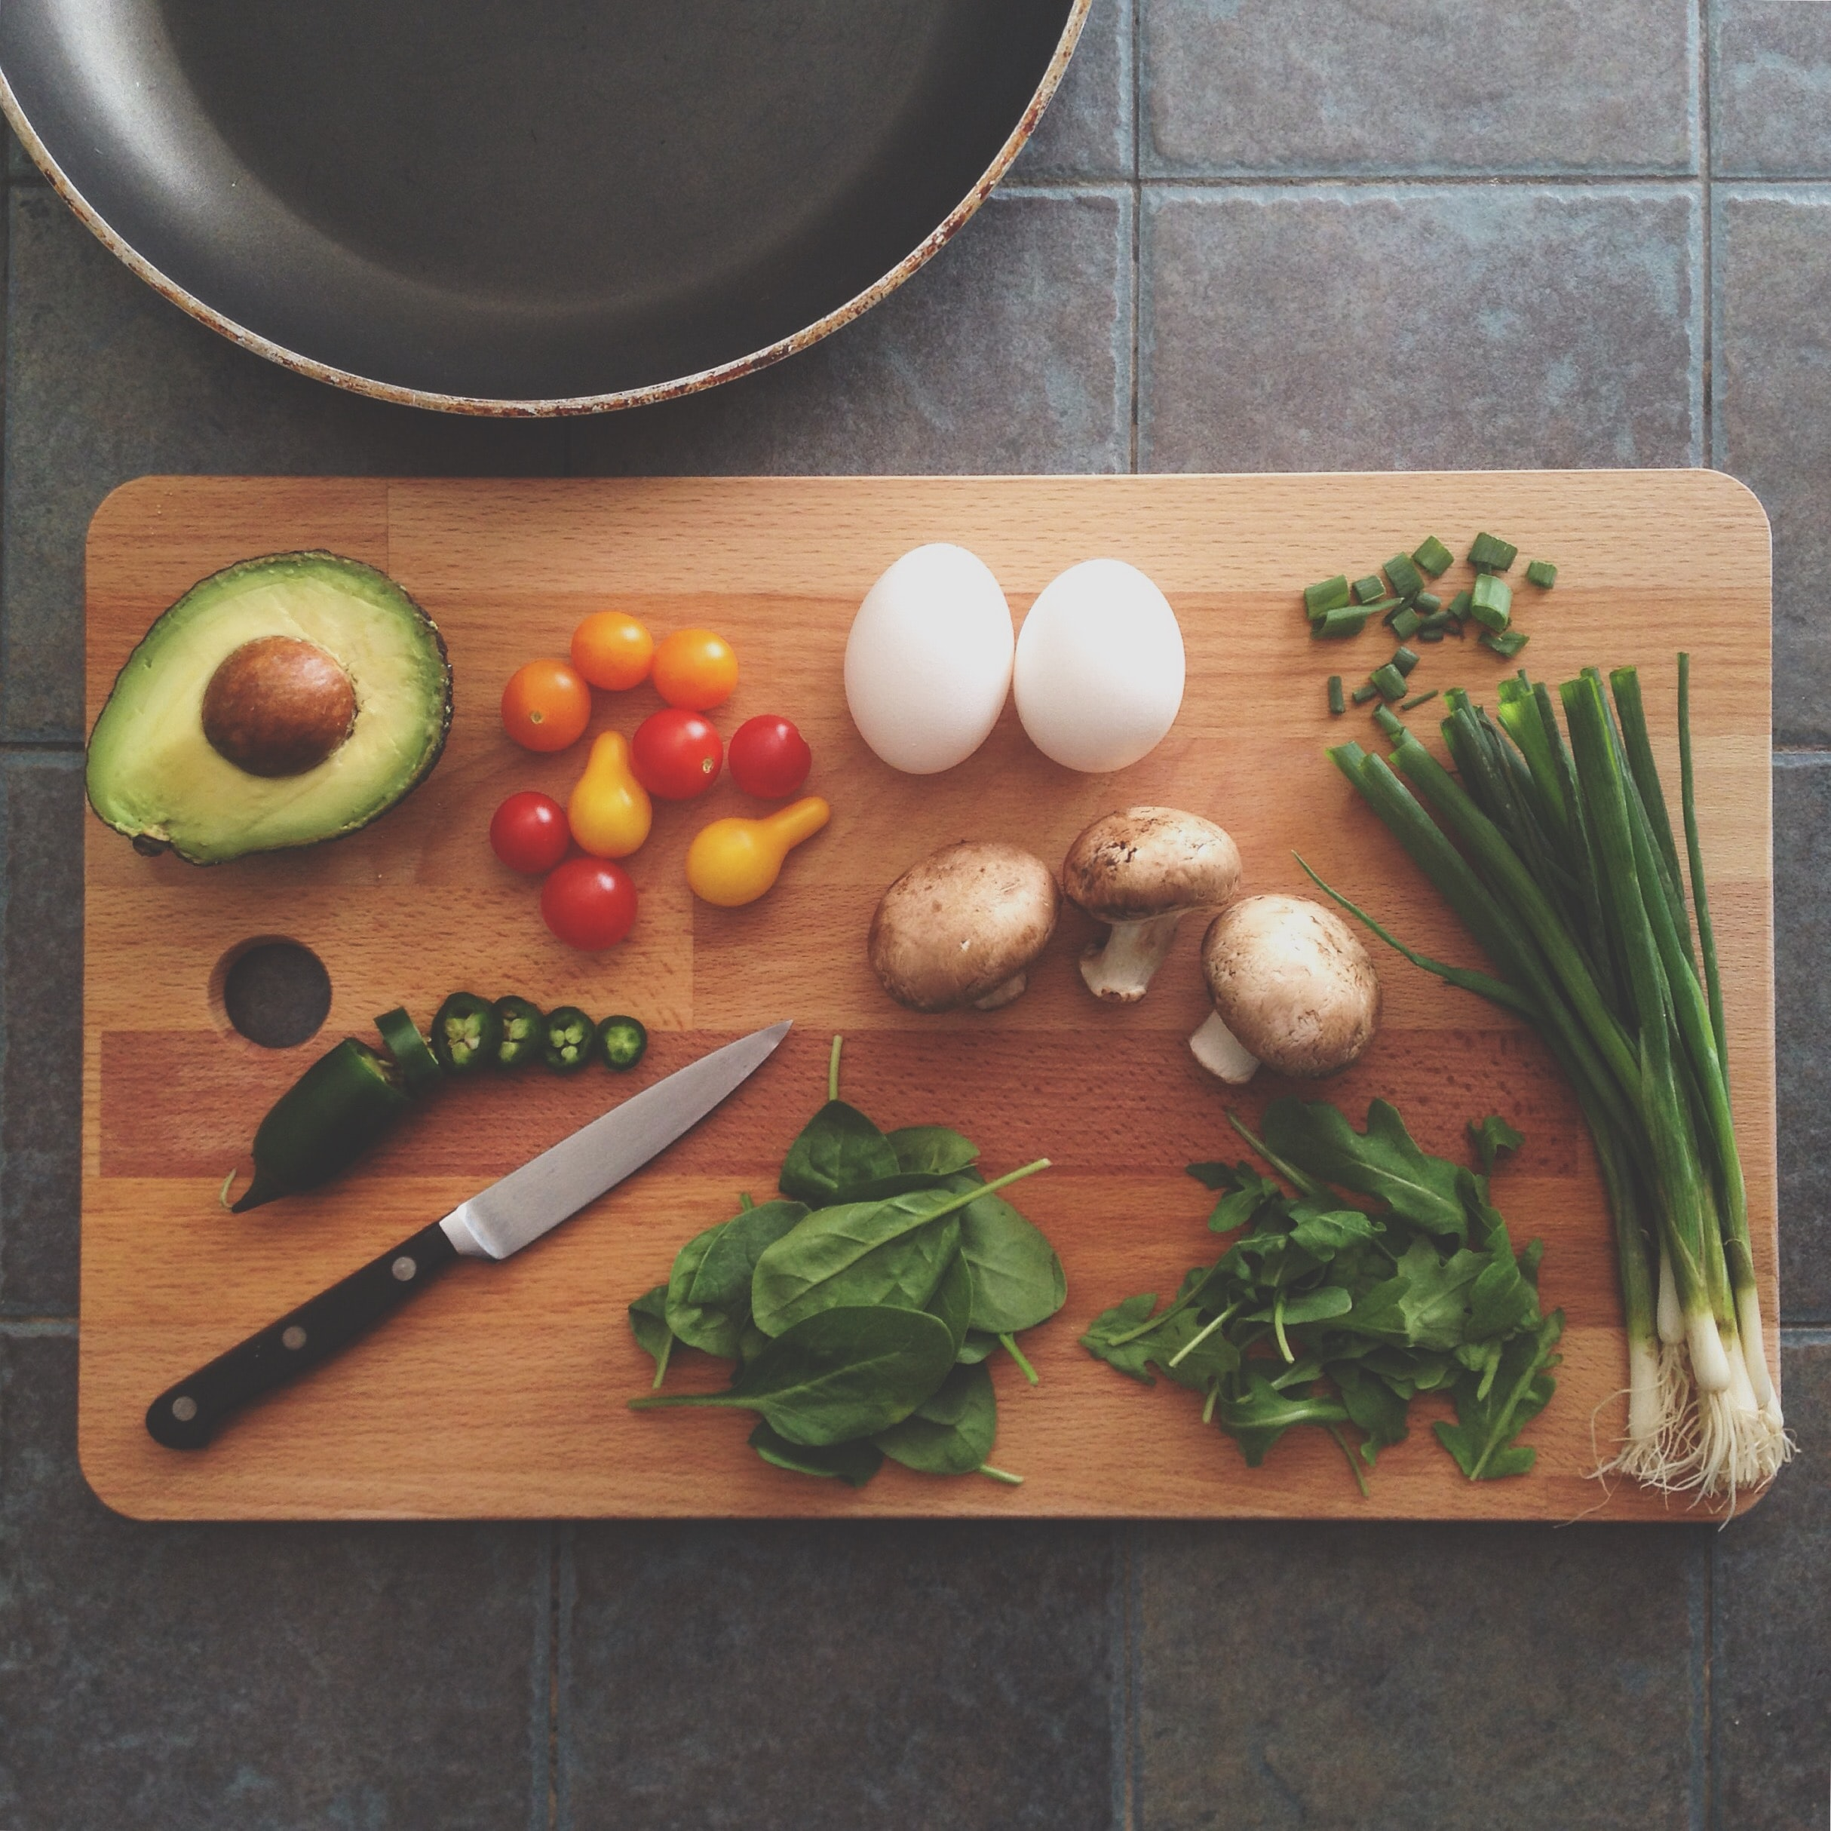
FridgeMate
By Adrienne Smith & Shelby El-rassi

Slide 2
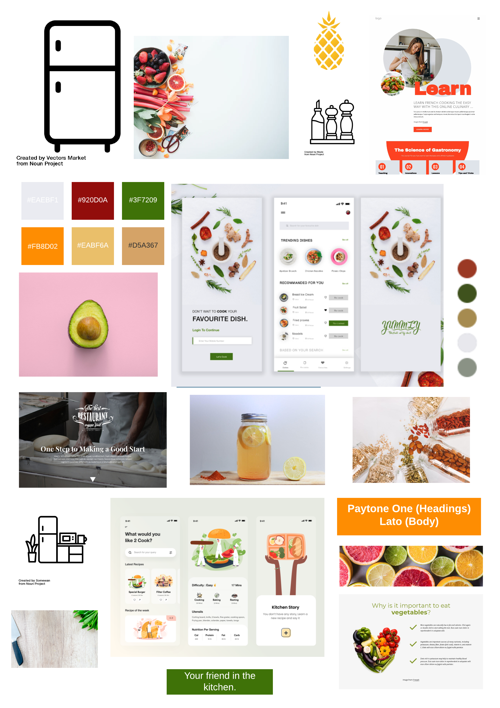
What:
An app to match your kitchen
ingredients to recipes!
Origins:
The idea for this web application stemmed from the situation of the first Australian lockdown of Covid19, in which stores sold out of a lot of popular and favourite grocery items of customers.
Users wanting to stick to a grocery budget, so they do not want to be constantly going to the store to get expensive ingredients.
Users needing recipe inspiration for their weekly meals, and to search recipes based on dietary requirements and excluded ingredients.
Users that are new to the cooking scene and want to start with cooking by just utilising ingredients already at home.
This app can help to minimise food waste by helping users to combine items they may not have made a meal with otherwise.
Notes:
“What are we building?”

Slide 3
Who:
Key Demographics
Gender: Anyone, predominantly women.
Age: 18-55.
Family status: Cooking for self, partner or dependents.
Profession: Students, professionals and homemakers.
Language: English.
Main interests: cooking, health, diet, low waste, saving money, trying new things.
Key Psychographics
Dislikes repetitive meals, like variety and new options.
Dislikes spending lots of money on lots of ingredients and food waste.
Enjoys sharing and preparing meals.
Challenges
Finds it difficult to create recipes.
Has a limited food budget or limited access to ingredients.
Has an interest in cooking but limitations (e.g. budget, dietary restrictions, skill).
Preferred Channels
Follows celebrity chefs and food themed accounts on social media.
Searches for recipes/blogs on Google.
Preferred Content Types
Articles. Blog posts. Social media posts.
Notes:
Just read the headings, “we thought about people’s…”

Slide 4
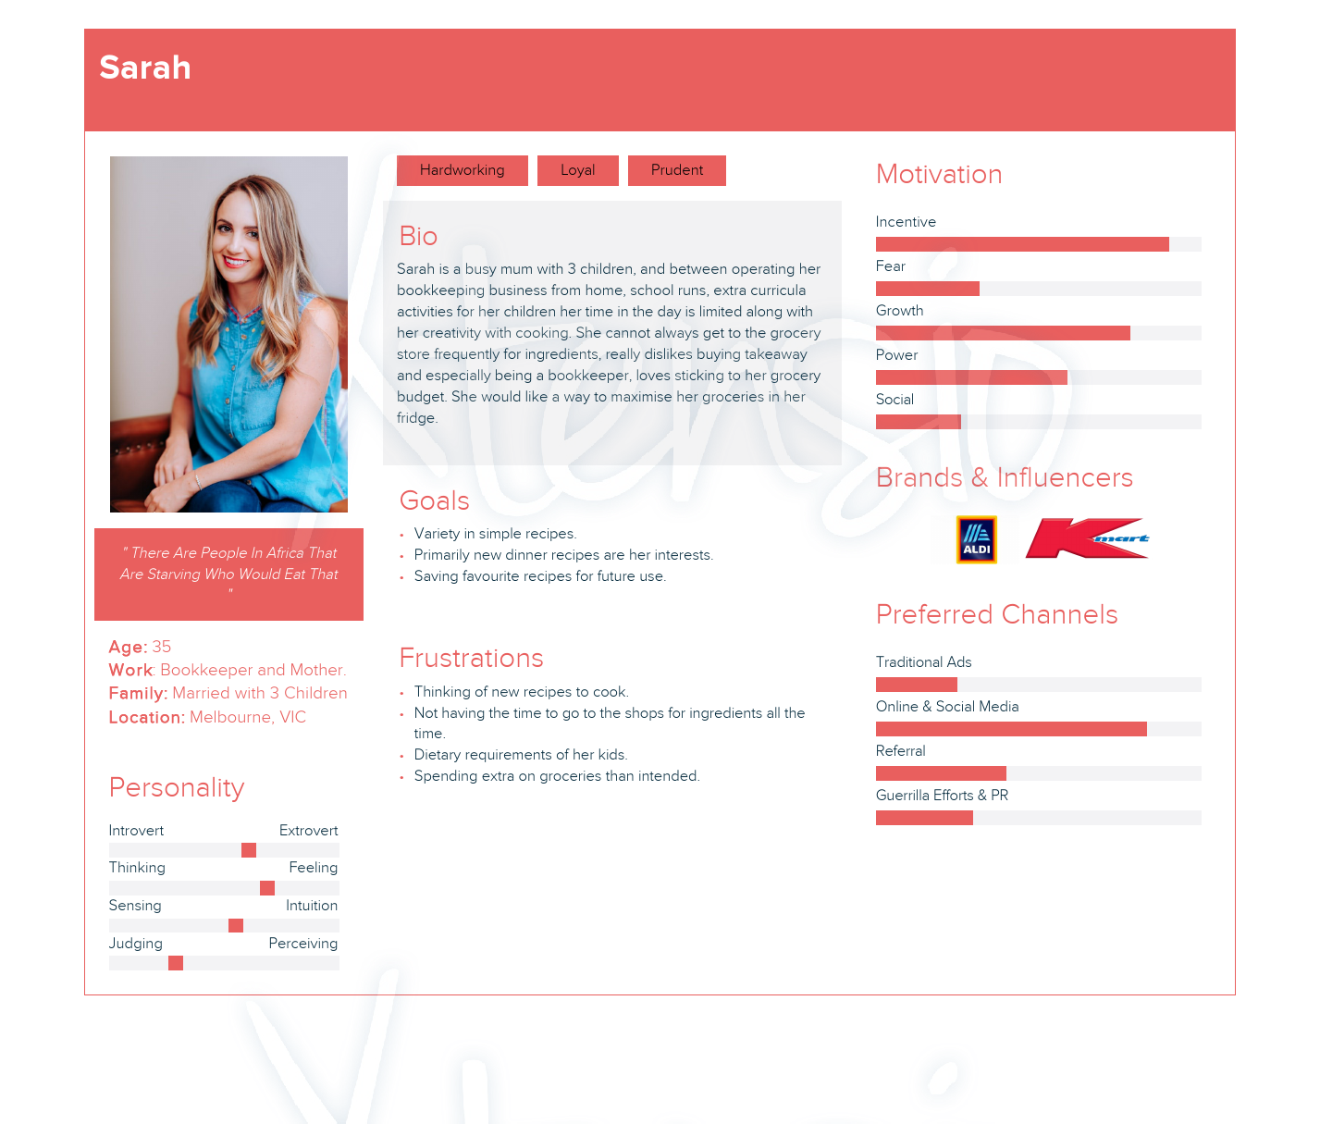
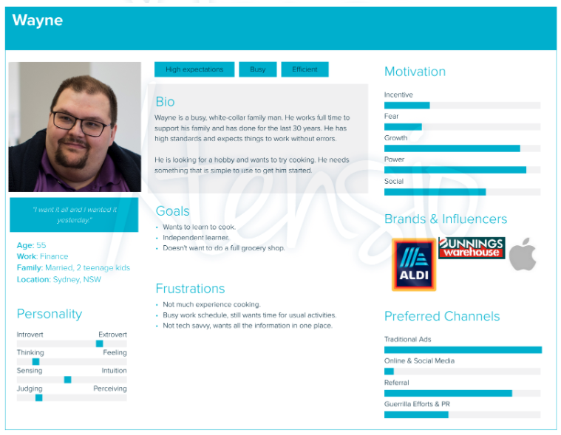
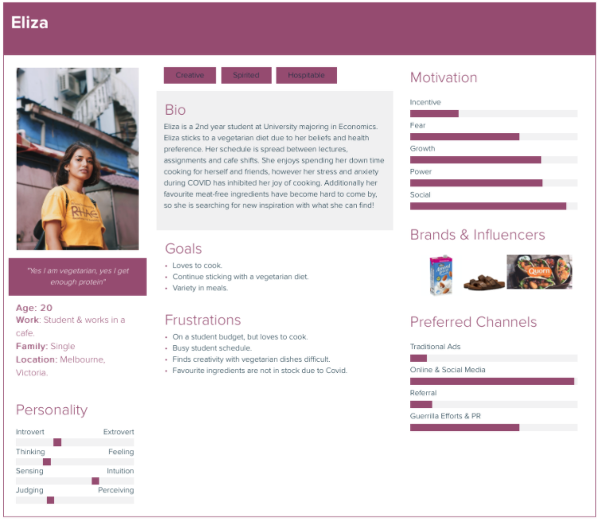
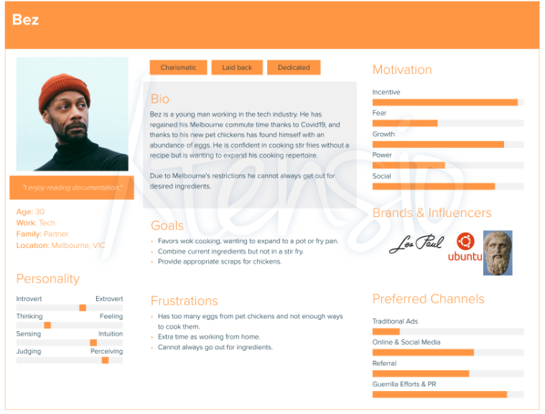
Who:
Sarah: Busy Employed Mother of 3
Wayne: Full time worker, new to cooking hobby.
Eliza: University student and vegetarian.
Bez: Tech worker with an egg surplus, an interest in learning different ways to cook them and some extra time for cooking.
User Stories:
Overall user stories
Stories for user profiles.
Stories for beyond MVP.
Notes:
We have 4 user personas.

Slide 5
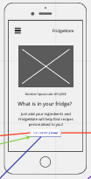
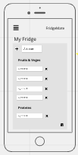
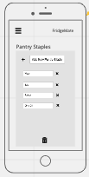
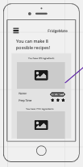
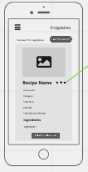
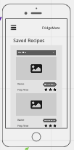
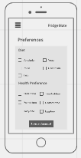
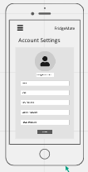
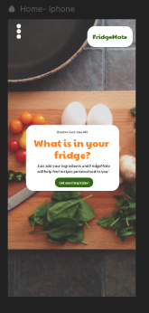
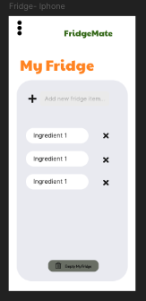
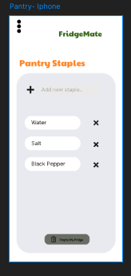
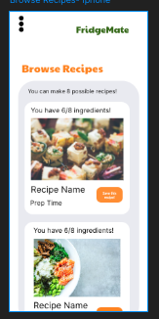
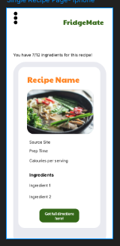
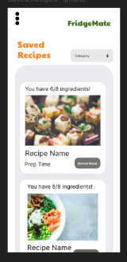
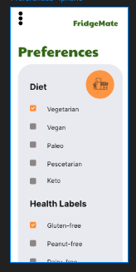
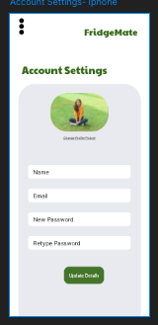
What:
Notes:
Skim over – we have all the wireframes

Slide 6
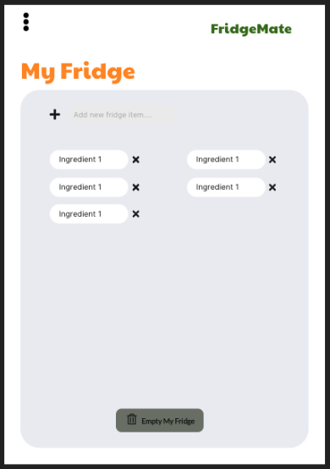
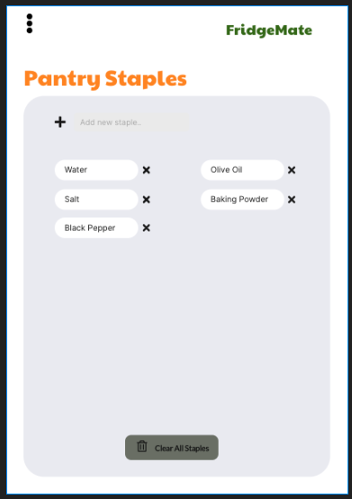
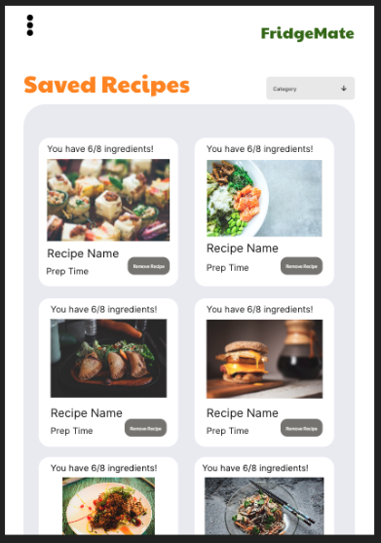
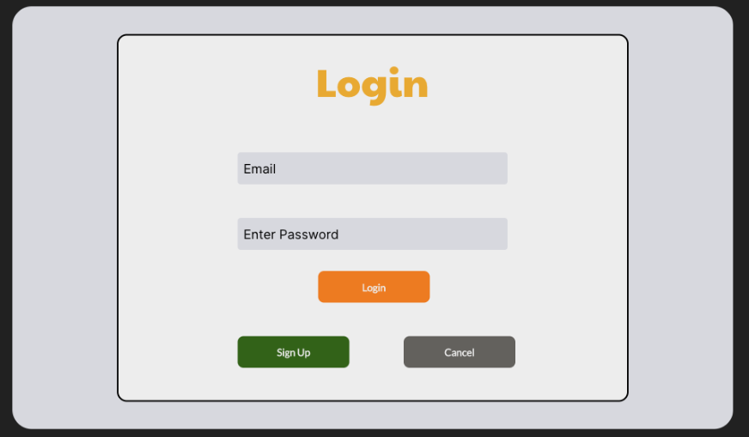
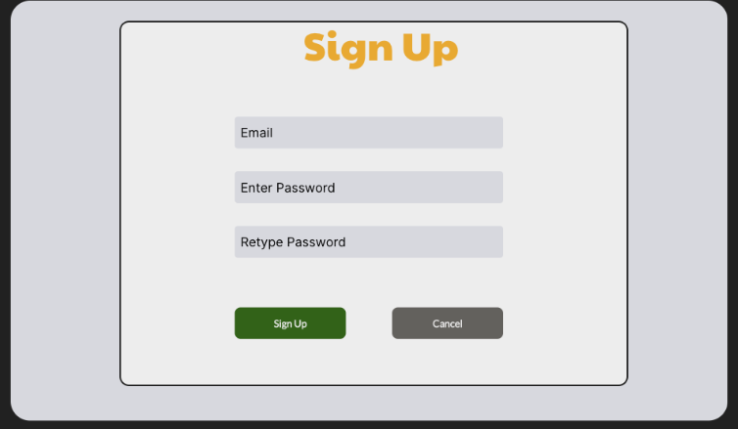
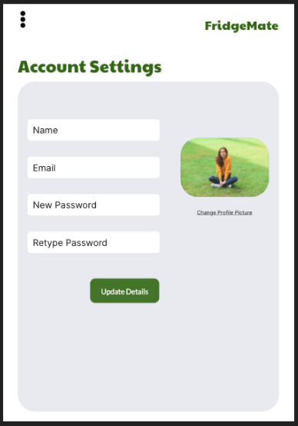
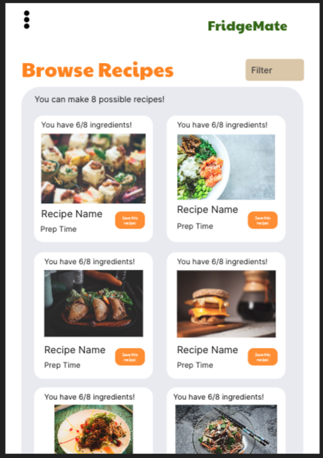
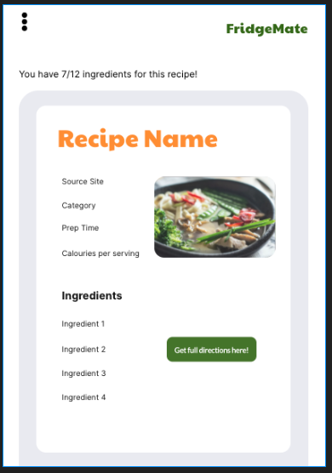
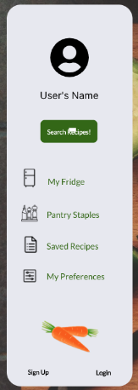
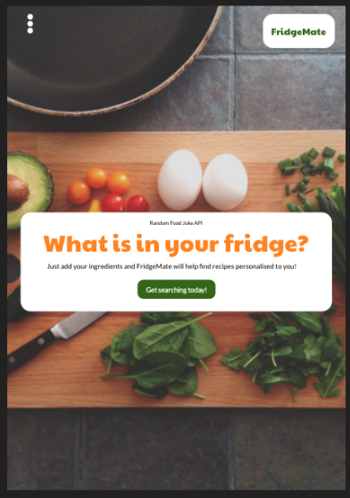
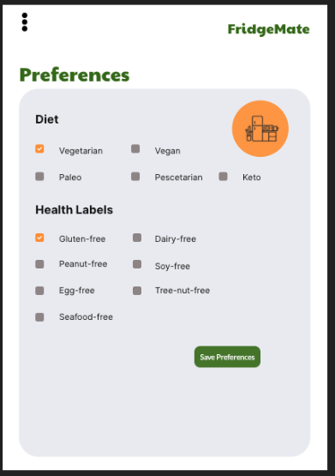
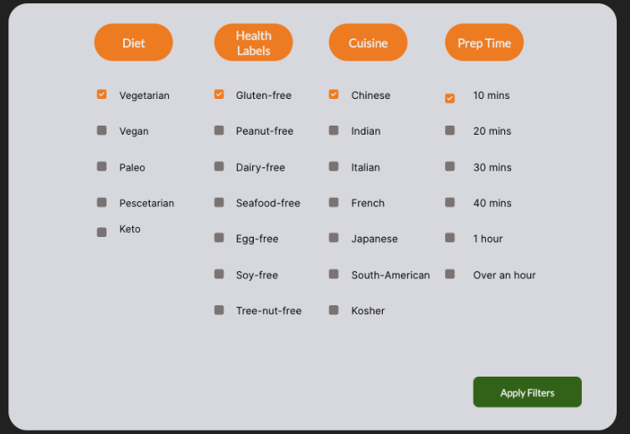
Notes:
Skim over – we have all the wireframes

Slide 7
MVP Features:
User Account and Authentication.
User accounts.
Account Settings
Preferences (diet and health labels)
Fridge/pantry ingredients.
Recipe search.
Save recipes.

Slide 8
Nice to have Features:
Search history.
Oauth.
Recipe of the week on home page.
Recipe Collections- Save recipes per collection. (eg. Breakfast, Chicken dishes etc).
Rate and review Recipes.
User Profile Advancements .

Slide 9
How:
Design and Planning
Trello (Planning)
Miro (Wireframing)
xtensio (Personas)
Framer (Prototypes)
Lucid Chart (Diagramming)
Slack (Team Communication)
Frontend
HTML5
CSS3
React JS
JavaScript
JSX
Material-UI
Axios (Http Requests)
Backend
ExpressJS
Node JS
Passport (Authentication)
Passport-JWT (Json Web Token Auth)
Express Session (Session Tracking)
AWS s3 (profile image Upload)
Database
MongoDB
Mongoose
Testing
Cypress- Front-end
Supertest- (Server Testing)
SuperAgent (Server Testing)
Mocha- (Testing Framework)
Other
Spoonacular API for Recipes
Heroku - (Deployment Server)
Netlify- (Deployment Client)
Notes:
Tech stack

Slide 10
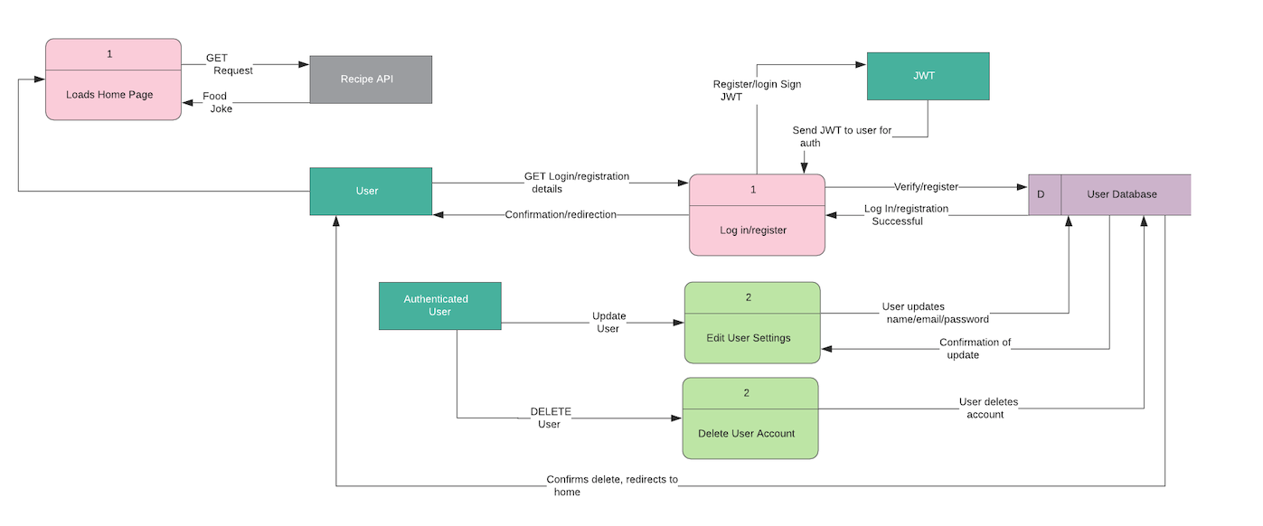
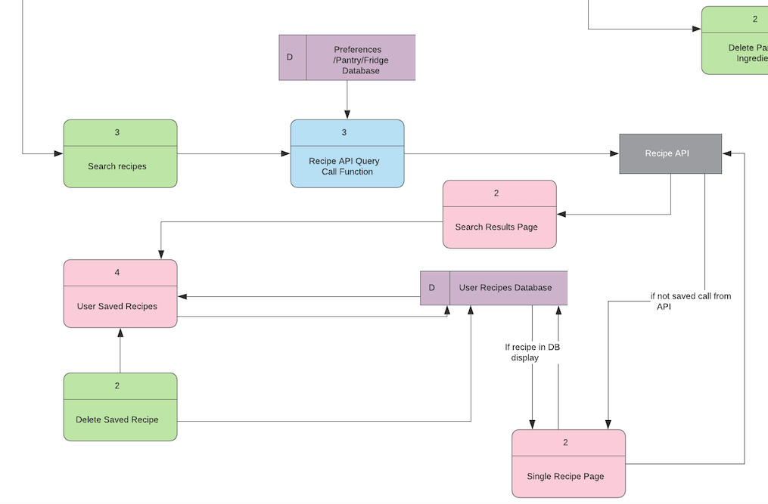
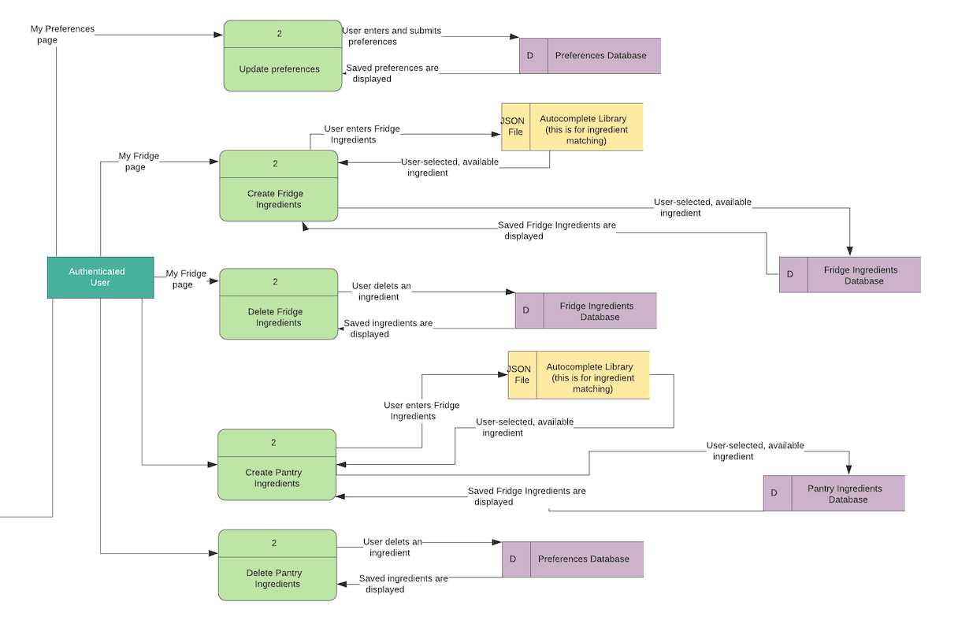
How:
https://github.com/CA-MERN/MERN-Part-A-Docs/blob/main/diagrams/DFD.jpeg
Notes:
Skim over – basically user needs to be logged in, user info and ingredients/preferences saved in DB, recipes come from API searching with DB info. They can click on the link if they want to see more.

Slide 11
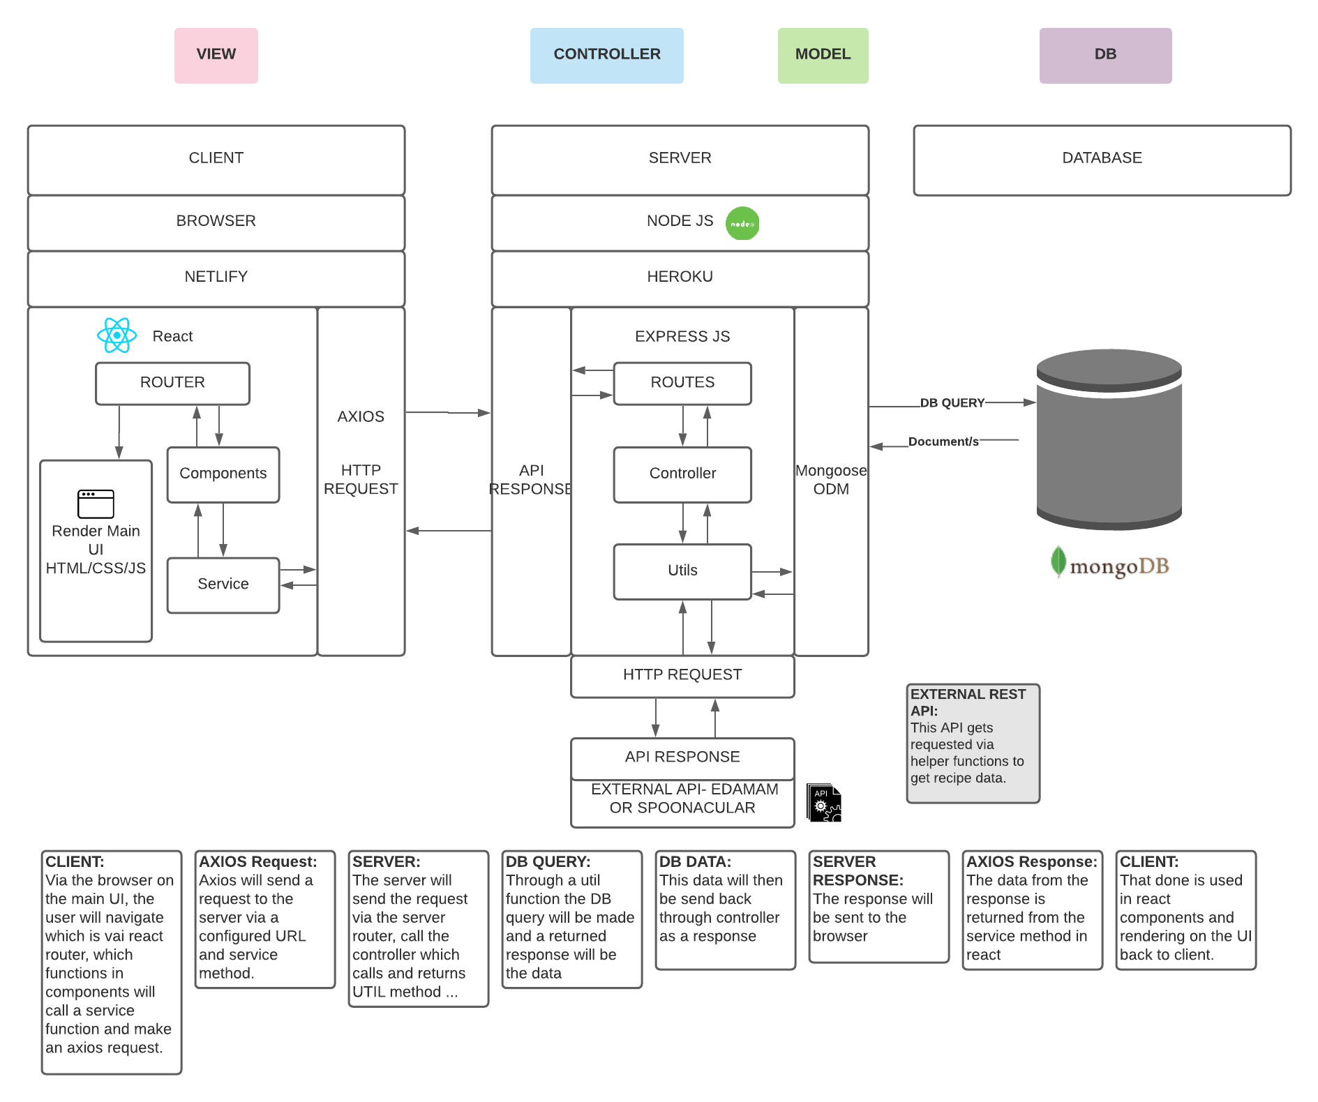
How:
https://github.com/CA-MERN/MERN-Part-A-Docs/blob/main/diagrams/aad.png

Slide 12
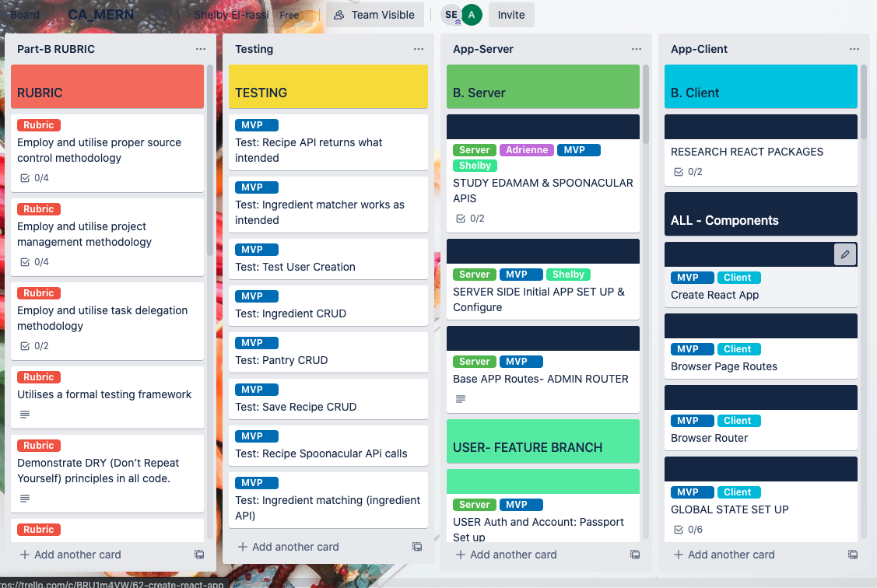
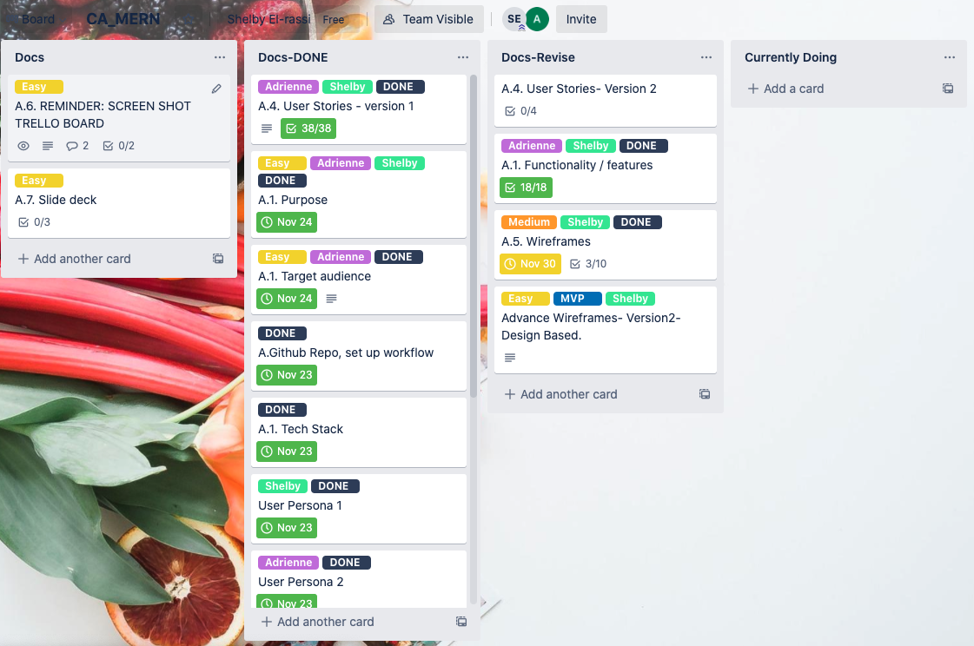
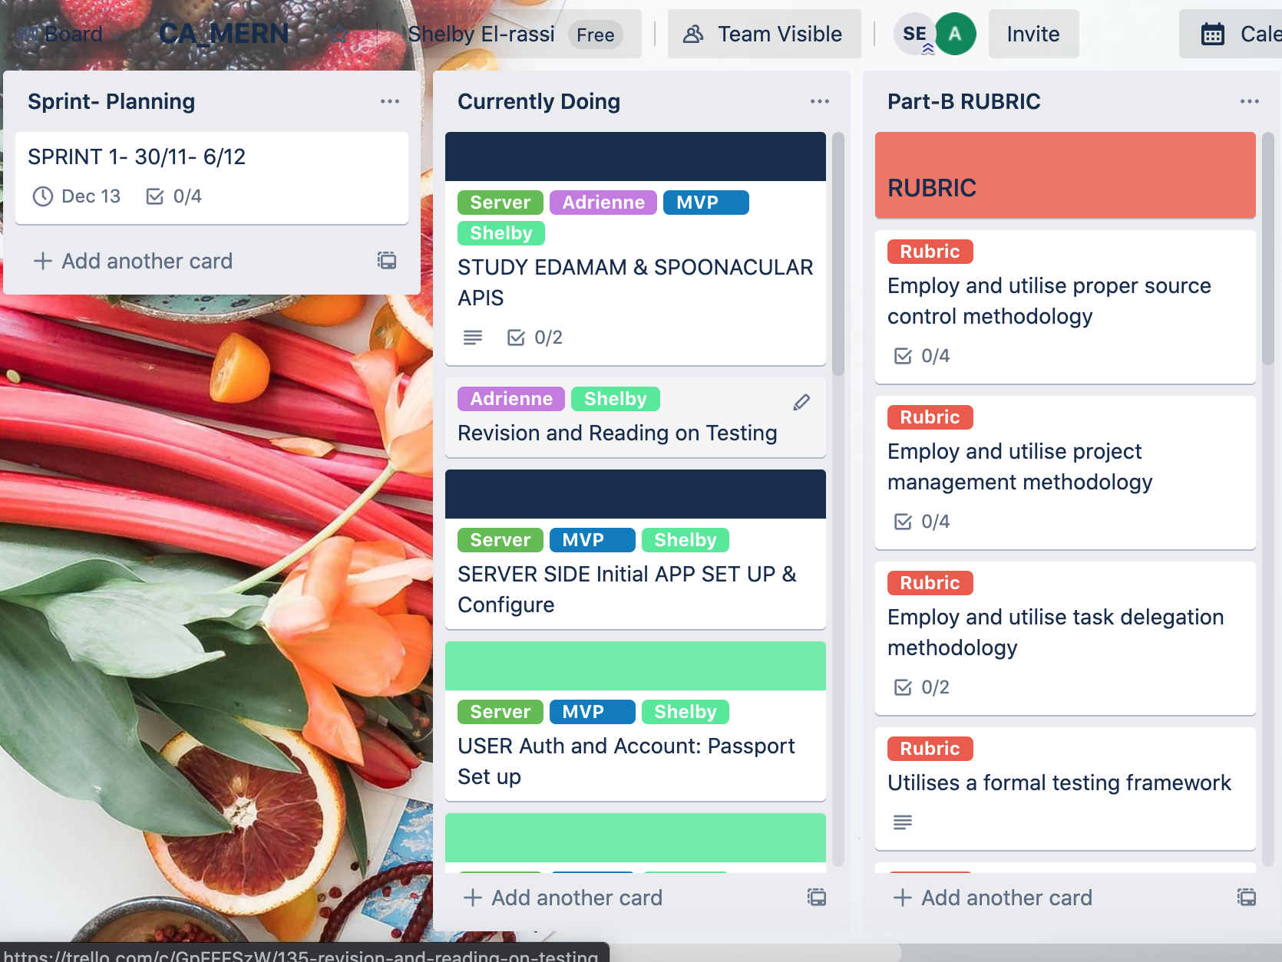
When:
Application Project Management
Rubric Card for Tracking
Testing Implementation
Server Implementation
Client Implementation
Docs Project Management
Original Card
Completed Card
Revision Card
Sprint Management
Sprint Planning Card
Currently Doing for that Sprint
Completed Card for that Sprint
Notes:
Using trello, doing sprints kind of?

Slide 13
THANK YOU
Notes:
Skim over – we have all the wireframes

